Slide 1

CTD Python Essentials
Week1 – Introduction to Python

Slide 2

Introducing Python
Preeminent scripting and glue language
Clean, simple syntax
“Executable pseudocode”
Huge ecosystem
Rich standard library
Large number of high quality 3rd party packages
Vibrant community
Object model

Slide 3
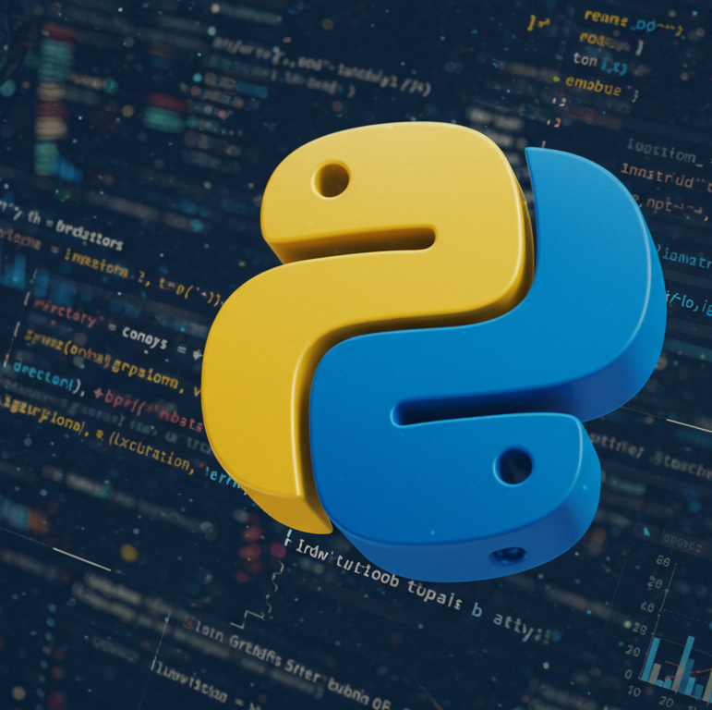
Python Applications
Important python domains (by no means comprehensive)
numpy – Numerical Python
High performance mathematical operations
scipy - Scientific Python
Advanced functions and algorithms built on numpy
Machine learning
PyTorch, tensorflow, Keras, scikit learn and many more
Web framework and APIs
Django, Flask
Data Science and Engineering
Pandas for cleaning and manipulation
Matplotlib for visualization
Rpython for statistics
Sqlalchemy – database ORM
Biopython for genomic data

Slide 4

History
Created in 1989 by Guido van Rossum at the Stichting Mathematisch Centrum in the Netherlands
A holiday hobby project
Based on previous work on a teaching language called ABC
Evolved in the shadow of perl in the 1990s, and eventually superseded it as perl6 foundered.
Perl: “There’s more than one way to do it.”
Python: “There should be one—and preferably only one—obvious way to do it” – the pythonic way.
Powerful binary libraries like numpy established python as the most important scripting language today
The evolution of the language is governed by the PEP process. Check out:
Style guide: PEP8
Zen of Python: PEP20

Slide 5

Python 2 vs 3
Python 3 was introduced in 2008
Significant changes which are incompatible with python 2
Unicode support
Print as a function
Integer division
Range() returns an iterator
Exception syntax changes
Python 2 was deprecated at the beginning of 2020 and should no longer be used
Run python –version to check (two dashes)
For backwards compatibility, some installations provide python as python3 and pip as pip3.

Slide 6

Installing Python
Lesson 1 provides detailed instruction on installing python and setting up the environment
CTD -> Python 100 v1 -> Introduction to Python
There is extensive documentation on python installation and setup here:
Python Setup and Usage — Python 3.13.2 documentation
The class uses several modules from pypi, the python package manager.
It is a convention to specify a list of requirements for a project in a file named requirements.txt.
Installed via pip install -r requirements.txt
We will manage packages using a virtual environment (venv).
When the venv is created and activated, you should see (.venv) in your prompt.

Slide 7
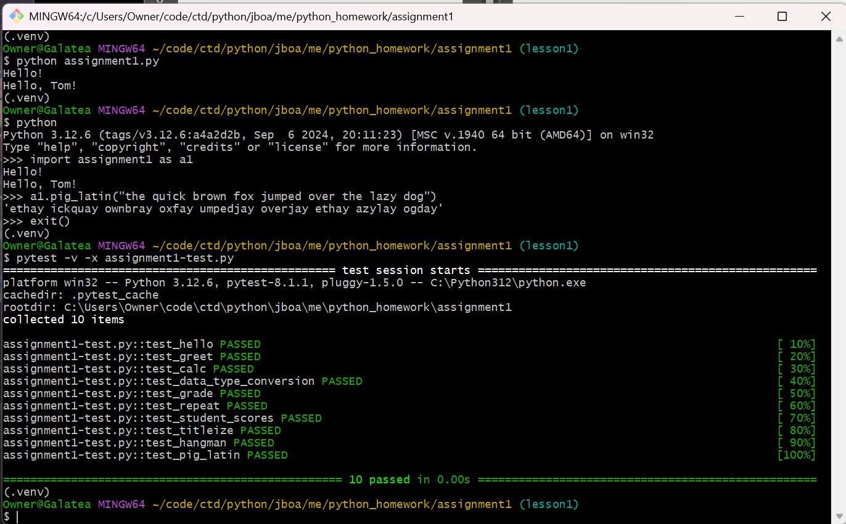
Running lesson examples and assignments
The homework will be organized in a separate directory (folder) for each lesson.
The folder contains a file for you code and unit tests
e.g. assignment1.py and assignment1-test.py
We recommend using a separate folder for running code samples from the lesson so the git workspace is not cluttered with temporary files.
We are using Test Driven Development for this class
Write the tests first, then write code which passes the tests
Run tests at the bash (zsh on Mac) command line:
pytest -v -x assignment1-test.py
-v is optional – it lists passing tests
Code samples and homework testing and debug can be run:
At the shell command line: python assignment1.py
In the python repl (Read Eval Print Loop):
>> Import assignment1 as a1
>> a1.my_func(my_args)
Depending on your environment, you can exit the repl using ctl-c, ctl-d, or exit()
If python hangs in git bash:
Add alias python='winpty python.exe'alias python='winpty python.exe’ to ~/.bash_profile

Slide 8
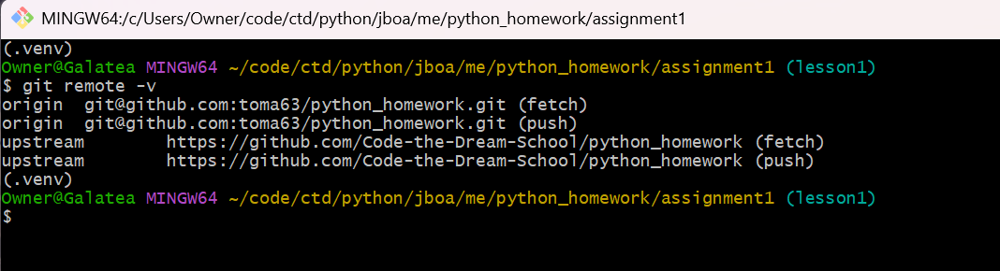
Homework repository setup
Detailed instructions are provided in the homework repo README.md file.
Rather than forking, you will:
Create a new empty repo called python_homework
Clone the school’s python_homework repo
Change the remote to your repo
Set the school’s repo as the upstream
This makes the default base for pull requests your repo, rather than the school’s
We may occasionally ask you to get the latest changes form the school’s repo:
git fetch upstream
git checkout main
git merge upstream/main

Slide 9
Syntax and scoping
Python has a sparse, clean syntax
No {} to specify blocks
No ; to end lines/statements
It is unusual in that it uses indentation to specify block structure
Lines can be continued using a ‘\’ character
Open (), {}, and [] also allow line continuation
Multiline strings use “””
Comments start with # and go to the end of the line
You can also use “”” for multiline comments such as docstrings
Python does not have block (lexical) scoping. It uses function scope.

Slide 10
Variables, datatypes, conversion
Variables are created by assigning to them
There is usually no declaration although they can be declared explicity global
The convention is to use lowercase names separated by ‘_’ (snake case, of course)
Basic datatypes
int, float, bool, complex
Sequential datatypes
list, tuple, str
Mapping (associative array): dict
Set: set
None: explicit lack of a value
Explicit conversion (recommended) use the name of the datatype:
int(), float(), bool(), complex(), list(), tuple(), str(), set(), dict()

Slide 11
Strings
A sequence of Unicode characters
Python provides a rich set of string methods
Strings are immutable
All of the immutable sequence methods can be used for strings

Slide 12
Truth in Python
The following are False in python
False
None
Zero of any numeric type
Empty sequences and collections: (), [], {}, set()
All other values are considered True

Slide 13

Operators
Logical:
and: True and False → False
or: True or False → True
not: not True → False
Not to be confused with bitwise operators
Bitwise:
& (bitwise and): 0xF0 & 0x0F → 0x00
| (bitwise or): 0xF0 & 0x0F → 0xFF
^ (bitwise exclusive or): 5 ^ 3 → 6
~ (bitwise not): ~0b0101 → -6 (2’s complement)
<< (left shirt): 5 << 1 → 10
>> (right shift): 0b1010 >> 1 → 5 (0b0101)
Arithmetic:
+ (addition): 3 + 2 → 5
- (subtraction): 5 - 3 → 2
* (multiplication): 4 * 2 → 8
/ (division): 9 / 3 → 3.0
// (integer division): 9 // 3 → 3
% (modulus, remainder): 7 % 3 → 1
** (exponentiation): 2 ** 3 → 8
Comparison:
== (equal to): 5 == 5 → True
!= (not equal to): 5 != 4 → True
< (less than): 3 < 4 → True
> (greater than): 10 > 5 → True
<= (less than or equal to): 5 <= 5 → True
>= (greater than or equal to): 7 >= 3 → True

Slide 14
Control flow
A test is anything which returns a True or False value
Or can be coerced to True/False
Assignment does not return a value in Python
So: while foo = makeSomething(): # doesn’t do what you might think
if <test>: [elif <test>:] [else:]
while <test>:
for <iteration-variable> in <sequence>|<iterator>:
Python does not have the c style for (;;) loop
range(<stop>) returns an iterator (starting with 0) which is often used in for loops
Range also supports range(<start>, <stop>[, <step>])
break can be used to jump out of a loop
continue can be used to skip to the next iteration

Slide 15
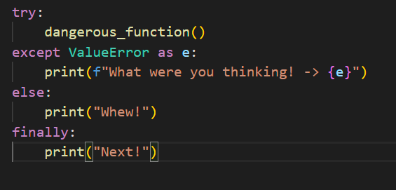
Exceptions
Python provides Exceptions to trap and manage errors and other exceptional conditions.
try:
Start of block of code which will be trap exceptions
There can be one of more except: blocks to capture specific exceptions.
else: clauses can be added which execute of an exception is not found
A finally: block can be added which runs regardless of exceptions
Exceptions can be nested
Custom exceptions can be created
Exceptions aren’t exceptional
A well design program should anticipate things which can go wrong
Exceptions should not be used for ordinary control flow

Slide 16
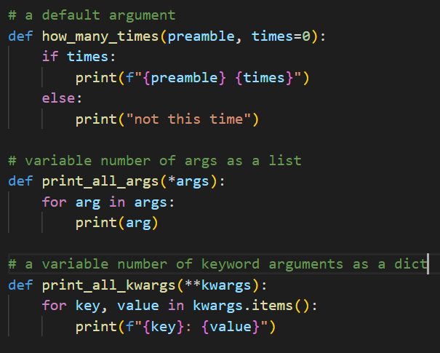
Functions
Functions are created using the def keyword
A function establishes an enclosing variable scope
Functions can be nested
Python has first class functions, they can be assigned to variables
Arguments are passed by reference
Default arguments are supported (e.g. numerical_arg=0)
The entire argument list can be referenced as a list (*args)
The entire argument list can be referenced as a keyword dict: (**kwargs)
Python supports a simple type of anonymous function called a lambda
lambda arg[…, arg]: <single expression>

Slide 17

Debugging
Unit tests
Checks correctness explicitly and can provide details on what’s wrong
Use print() – add as needed to see what’s going on
The traceback module used in conjunction with exceptions
Example in lesson 2
Shows where the failure is in the function call stack
The logging module
Varying levels and control of verbosity
The python debugger in conjunction with a vscode plugin – lesson video

Slide 18
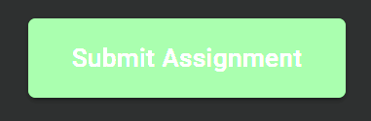
Submitting assignments
Make sure unit tests are passing
As with other classes:
Create a branch for all the code and other files in the assignment
Commit all your changes to the branch
Push the branch to your python_homework repo
Use the branch to create a pull request
Submit your lesson including the pull request:
Answer the other questions in the form

Slide 19

Demo and Q&A

